Slide 1
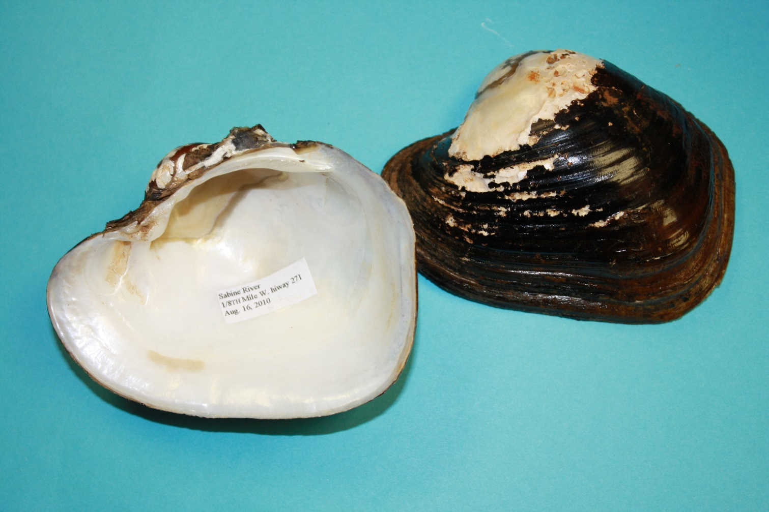
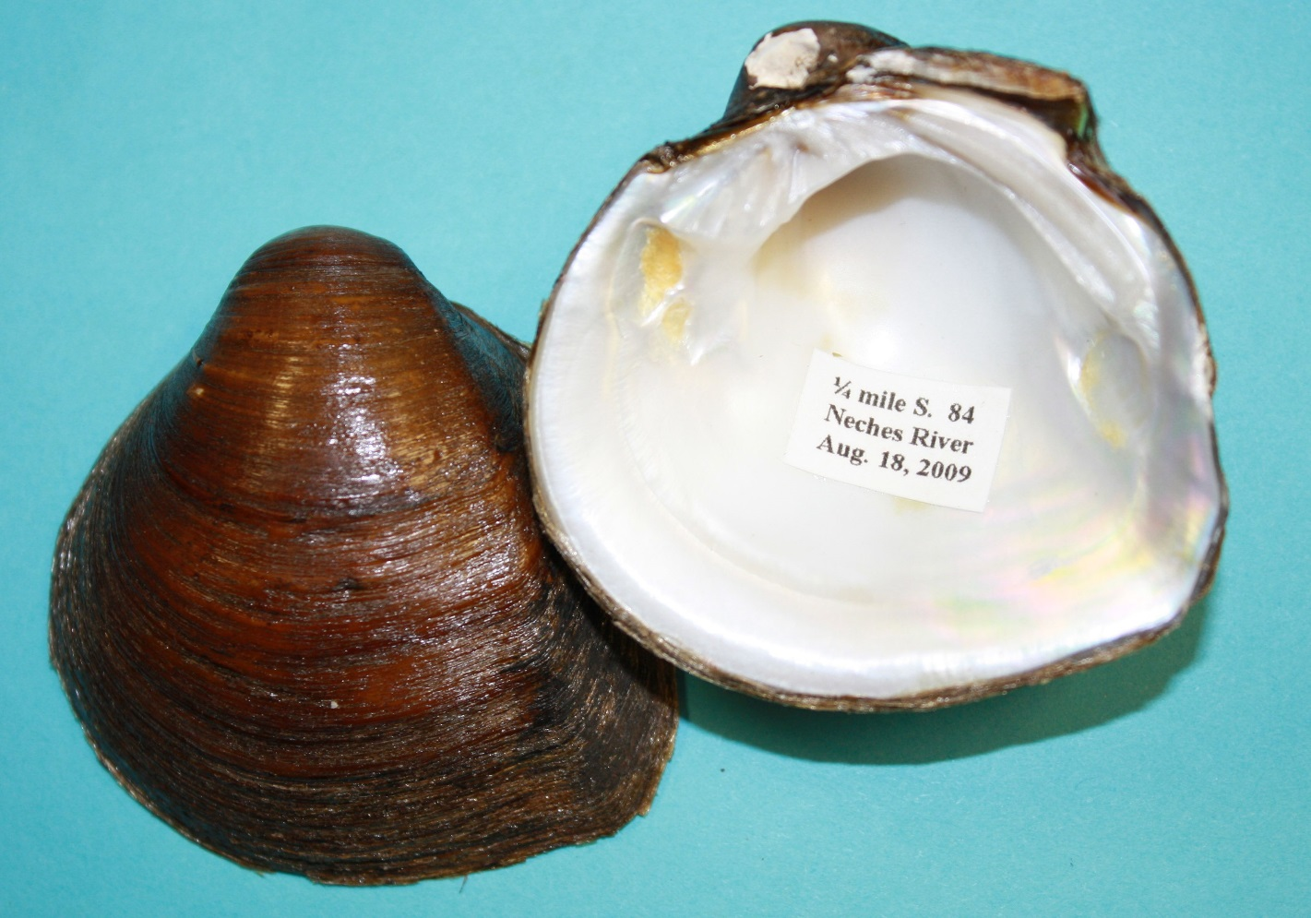
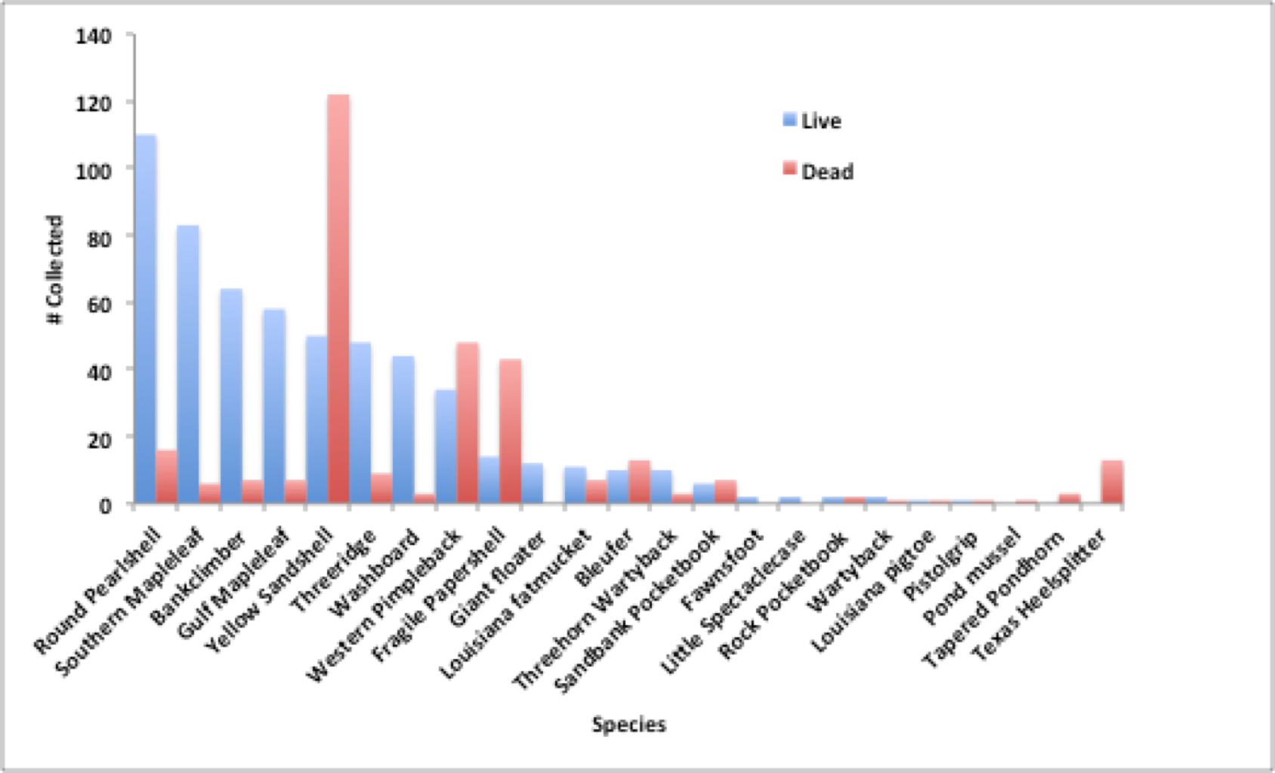
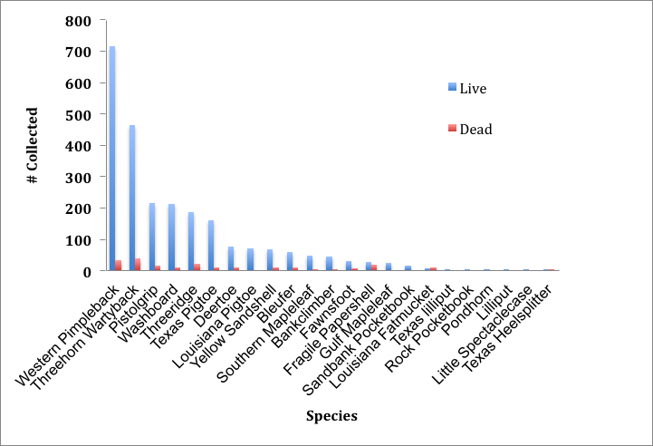
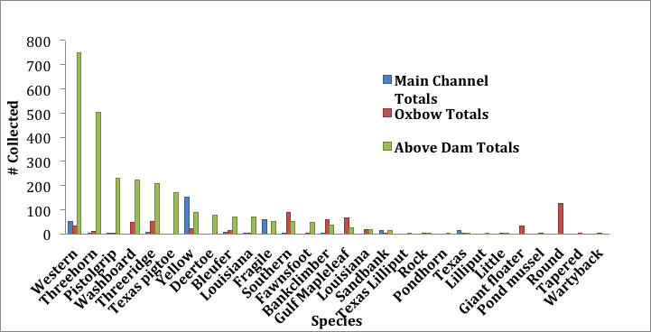
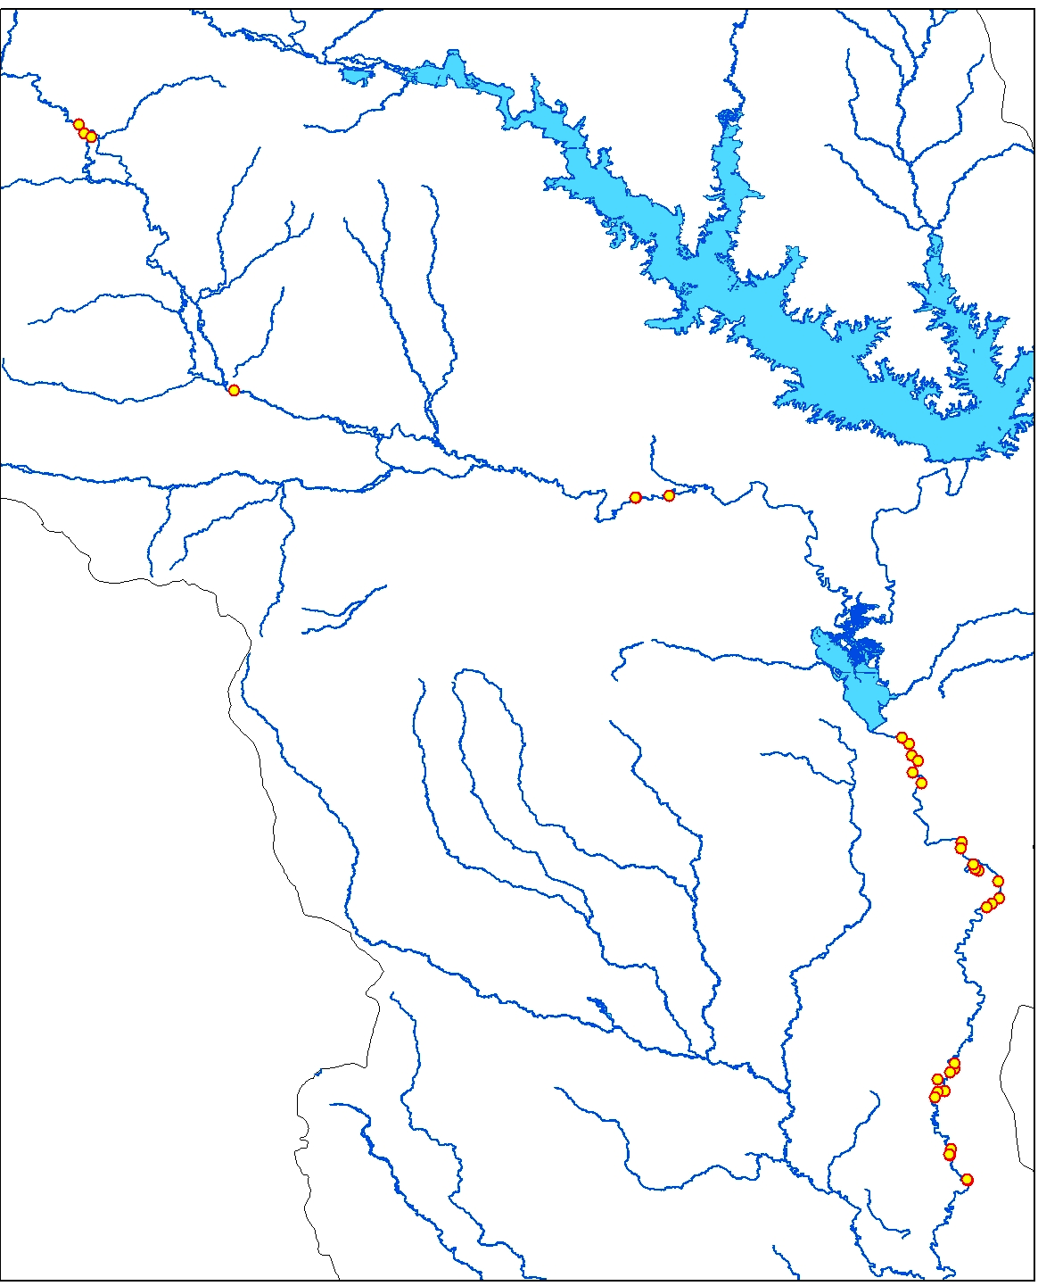
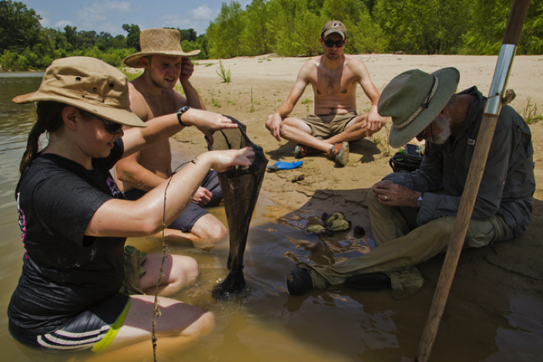
Impact of a hydroelectric dam on mussels in the Neches River
Neil Ford, ¹David Ford and ²Ashley Walters
Department of Biology, The University of Texas at Tyler, 3900 University Blvd. Tyler, Texas 75799
¹Halff Assoc. Inc., 1201 N. Bowser Rd. Richardson, TX 75081
²Dept. of Zoology, Miami Univ., Oxford, OH 45056
Abstract: Dams are known to modify the river downstream, such that Unionid mussel diversity and abundance decline. We surveyed for mussels in the Neches River above and below the hydroelectric dam at B. A. Steinhagen. We sampled 10 sites from 80 km above and 30 sites below the dam to 55 km further downstream. 19 of the downsteam sites were from the main stem of the river and 9 in oxbows and tributaries off the main channel. We collected 2430 live and 195 dead of 21 species upstream of the dam. We recorded 23 species below the dam, 312 total in the main channel, 572 in the oxbows. Although species diversity was approximately the same, the abundance of mussels was much lower below the dam and most of the mussels were found in oxbows, which apparently were refuges from the variable flow releases from the dam. The species found on the main channel were primarily those that can live in the shifting sands of that part of the river. However, two threatened species, Sandbank Pocketbook and Texas Heelsplitter were found there. Two other threatened species, Texas Pigtoe and Louisiana Pigtoe, were much more abundant above the dam. The habitat of the river was very different below the dam and stable substrate was not available for mussels in the main channel suggesting it has been heavily impacted by the variable flows from the dam.
Methods
We conducted 10 surveys for mussels on the mainstem of the Neches River from 80 km upstream of B. A. Steinhagen and 30 surveys in 3 units of the Big Thicket to 55 km below the dam (Fig. 1). Nine of the latter were on tributaries or oxbows off of the mainstem. These lower reaches included the Upper Neches River Corridor Unit just south of Dam B, Canyonlands Unit and the Neches Bottom and Jack Gore Baygall unit. We scouted the river by boat for suitable habitat, and then conducted timed hand searches within 100 to 150 meter reaches. Timed searches are the best method to obtain the most species (Strayer et al., 1997; Strayer and Smith, 2003; Vaughn, et al., 1997). All live and dead unionids were collected, identified, counted and live were returned to the river. Vouchers of recent dead specimens of threatened species were retained in the University of Texas at Tyler collection.
Discussion
Although 23 of the potential 42 species were found below B. A. Steinhagen reservoir, the distribution of the locations with high abundance was disturbing. The main stem of the river has much higher abundance of mussels above B. A. Steinhagen than below. The main stem below the dam had very few mussels down to highway 96. The dramatic fluctuations in water releases has eroded the river banks and all good habitat (gravel and cobble) is covered in shifting sand which most species of mussels can not tolerate. Therefore, the upper Neches River Corridor unit near the dam is now poor habitat for mussels. In the Canyonlands unit and the Neches Bottom and Jack Gore Baygall unit urther downstream, the Neches River has numerous oxbows and tributaries into the river. These backwaters appear to be refuges from the high shear stresses during water releases from B. A. Steinhagen. All of these sites had higher abundances and often a high diversity of mussels. Still they had much lower numbers than the mainstem of the river upstream. Further surveys should concentrate on the oxbows and inlets into the river as they should exhibit higher diversity and potential rare species. In addition, some discussions with the river authority to mitigate the dramatic high flows would be important to improve conditions for mussels below the dam. Without that reduction in shear stress the outlook will remain poor for this fauna in this part of the Neches River.
In conclusion the diversity and abundance of mussels was compared above and below B. A. Steinhagen Reservoir. The main stem of the Neches River had high abundance and diversity above the dam but low abundances and diversity below the dam. However, there were two threatened species found on the main stem below the dam. Somewhat higher diversity and abundance of mussels were found in the backwater areas of Canyonlands and the Neches Bottom and Jack Gore Baygall unit. The protection these areas provide for this declining fauna is therefore quite important and further monitoring is warranted.
Results.
Below B. A. Steinhagen we collected 564 live and 313 recent dead mussels of 23 species in the 30 surveys (Fig. 3). Only 89 of the live came from the mainstem whereas the oxbows had 480 live mussels. We collected 2430 live and 195 dead mussels of 21 species from the 10 sites in the mainstem above the dam (Fig. 4.).
Fig. 3. Mussels collected below B. A. Steinhagen. Fig. 4. Mussels collected above B. A. Steinhagen
The diversity of mussels was similar both above and below the dam but the numbers collected was much higher upstream even though only 1/3 of the sites were sampled (Fig. 5). Above the dam two species dominated (Western Pimpleback and Threehorn Wartyback) but many exhibited significant abundance (Fig. 3). Threatened Texas pigtoe and Louisiana pigtoe were 6th and 8th most abundant species. The threatened Sandbank Pocketbook and Texas Heelsplitter were rare.
Fig. 5. Total mussels collected both above and below B. A. Steinhagen
The salt tolerant Round Pearlshell was the most abundant species below the dam. The Sandbank Pocketbook was the only threatened species found live in more than very few locations. It was found in several of the sandbars along the main stem of the river but not in the backwaters. These oxbows had the highest diversity and appeared to be refuges from the high shear stresses of the river. Although a number of Texas Heelsplitters were also found in the sandbars of the mainstem, they were always dead. Yellow Sandshell was the only species common in the main stem of the river. Of the other threatened species, only a very few dead Louisiana Pigtoes were found below the dam.
Introduction:
Freshwater mussels have historically dominated rivers of the southeastern United States in benthic biomass and often in dense multispecies beds that remove organic material, move sediments and provide habitat for other animals (Vaughn and Hakencamp, 2001). They are sensitive to most environmental problems and so are widely recognized as indicator species for water quality. North American mussel populations have declined with 35 species now presumed extinct and nearly 50% imperiled to some degree (Neves et al., 1997) and 15 species have been listed as threatened in Texas (Ford and Nicholson, 2006; Ford et. al., 2009). Texas has over fifty species in multiple river basins that often have isolated drainage into the Gulf of Mexico (Howells, et al., 1996). In east Texas a number of reservoirs and smaller impoundments have been constructed on rivers and streams. The rivers downstream of dams are subjected to instream flows that are occasionally extremely high and variable. This causes two impacts on mussels (Vaughn and Taylor, 1999). The high flows scour the substrate and remove mussels entirely. The variable flows cause bank erosion and the movement of large amounts of sand downstream. Only mussel species that can move in these shifting sands can survive in this habitat. In addition, hydroelectric dams release cooler deep water in large amounts in the summer for electrical requirements, and this water can inhibit reproduction in some species. The Neches River is the main water source for the units of the Big Thicket National Preserve and a hydroelectric dam (Dam B forming B. A. Steinhagen reservoir) is just upstream of these units. It seems likely that this dam has impacted the mussel populations but mussel surveys in the area are limited and dated.
Fig. 2. Collecting mussels below B. A. Steinhagen.
Fig. 1. Neches River upstream and downstream
from B. A. Steinhagen Dam where surveys
were conducted.
Literature Cited
Burlakova LE, D. Campbell, A. Y. Karatayev, and D. Barclay. 2012. Distribution, genetic analysis and conservation priorities for rare Texas freshwater molluscs in the genera Fusconaia and Pleurobema (Bivalvia: Unionidae). Aquatic Biosystems 8:12.
Ford, N. B. and M. L. Nicholson. 2006. A survey of freshwater mussels (unionidae) of the Old Sabine Wildlife Management Area, Smith County, Texas. Texas J. Sci. 58: 243-254.
Ford, N. B., J. Gullett, and M. E. May, 2009. Diversity and abundance of unionid mussels in three sanctuaries on the Sabine River in northeast Texas. Texas J. Sci. 61: 279-294.
Howells, R.G., R. W. Neck and H. D. Murrey. 1996. Freshwater mussels of Texas. Texas Parks and Wildlife Press, Austin,Texas.
Neck W. 1982. Preliminary analysis of the ecological zoogeography of the freshwater mussels of Texas In Proceedings of a Symposium on recent benthological investigations in Texas and adjacent states. Texas Academy of Science 33-42.
Neves, R.J. et al. 1997. Status of aquatic mollusks in the southeastern United States: a downward spiral of diversity Pages 43-86 In: Aquatic Fauna in Peril: The Southeastern Perspective Special Publication 1 (G.W. Benz and D.E. Collins) Southeast Aquatic Research Institute. Boone, North Carolina.
Strayer, D.L. 2008. Freshwater mussel ecology: a multifactor approach to distribution and abundance. University of California Press, Berkley and Los Angeles, CA. USA.
Strayer, D. L., S. Claypool, and S. J. Sprague. 1997. Assessing unionid populations with quadrats and timed searches. Pages 163–169 in K. S. Cummings, A. C. Buchanan, C. A. Mayer, and T. J. Naimo, editors. Conservation and management of freshwater mussels. II. initiatives for the future. Proceedings of a Symposium, 16–18 October 1995, St. Louis, Missouri. Upper Mississippi River Conservation Committee, Rock Island, Illinois.
Strayer, D. L. and D. R. Smith, 2003. A guide to sampling freshwater mussel populations. American fisheries Soc. Monograph 8. Pp. 103.
Vaughn, C.C. and Taylor, C.M. 1999. Impoundments and the decline of freshwater mussels: a case study of an extinction gradient. –Conserv. Biol. 13: 912-920.
Vaughn, C.C., C.M. Taylor and K.J. Eberhard. 1997. A comparison of the effectiveness of timed searches vs. quadrat sampling in mussel surveys. Pages 157-162, in Cummings, K.S., A.C. Buchanan, C.A. Mayer and T.J. Naimo (eds)., Conservation and Management of Freshwater Mussels II: Initiatives for the Future. Proceedings of a UMRCC symposium, 16-18 October 1995, St. Louis, Missouri.
Acknowledgements:
We would like to thank Robert Howells of Biostudies Inc. for advice throughout this study. The project was funded by grants from the Thicket of Diversity, Texas Parks and Wildlife and the United States Fish and Wildlife Service.

